Slide 1
Linear Algebra

Slide 2
Suggested Books
Serge Lang, Introduction to Linear Algebra, 2nd Edition, Springer, 1986.
Gilbert Strang, Introduction to Linear Algebra, 4th Edition, Wellesley-Cambridge Press, 2009.

Slide 3
LINEAR ALGEBRA

Slide 4
Outline
Vector arithmetic
Matrix arithmetic
Matrix properties
Linear Independence
Bases & Orthonormal Bases
Determinant of a matrix
Rank of a Matrix
Eigenvectors & eigenvalues
System of linear equations
Principal Component Analysis
Singular Value Decomposition
Applications

Slide 5
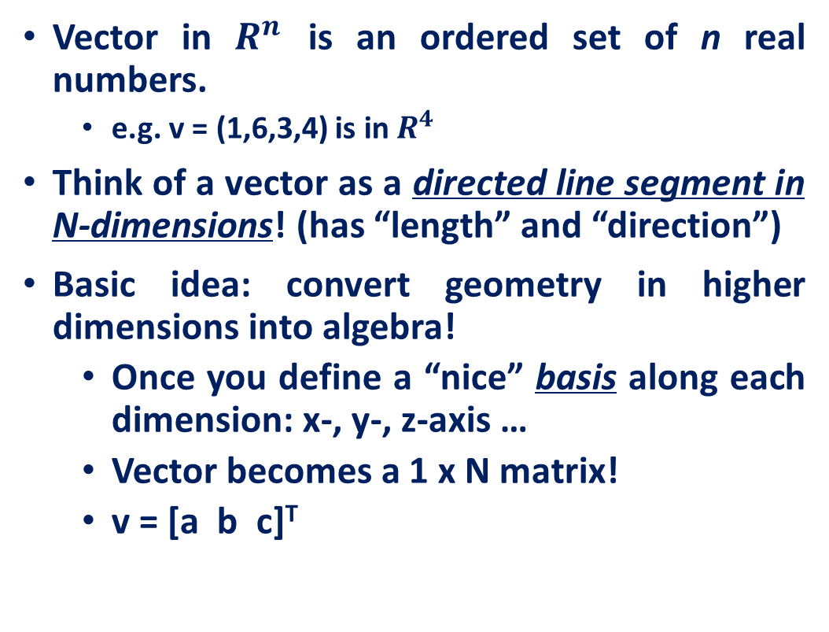
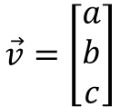

What is a Vector ?
Vector in $R^{n}$ is an ordered set of n real numbers.
e.g. v = (1,6,3,4) is in $R^{4}$
Think of a vector as a directed line segment in N-dimensions! (has “length” and “direction”)
Basic idea: convert geometry in higher dimensions into algebra!
Once you define a “nice” basis along each dimension: x-, y-, z-axis …
Vector becomes a 1 x N matrix!
v = [a b c]^{T}
$$\vec{v}=\left[\begin{aligned}a \\ b \\ c\end{aligned}\right]$$
$$\vec{v}=\left[a b c\right]$$
Row vector
Column vector
y
v
x

Slide 6

What is a Matrix?
A matrix is a set of elements, organized into rows and columns
rows
columns
$$\left[\begin{matrix}a_{11} & a_{21} & a_{31} & a_{41} \\ a_{12} & a_{22} & a_{32} & a_{42} \\ a_{13} & a_{23} & a_{33} & a_{43} \\ a_{14} & a_{24} & a_{34} & a_{44}\end{matrix}\right]$$

Slide 7
Vector Addition
a+b
$$v+w=(x_{1},x_{2})+(y_{1},y_{2})=(x_{1}+y_{1},x_{2}+y_{2})$$
a
a+b = c
b
c
b
a

Slide 8
Scalar times Vector
Change only the length (“scaling”), but keep direction fixed.

Slide 9
Product of 2 Vectors
Three ways to multiply
Element-by-element
Inner product
Outer product

Slide 10
Element-by-element product (Hadamard product)
Element-wise multiplication (.* in MATLAB)

Slide 11
Vectors: Dot Product (inner product)
Think of the dot product as a matrix multiplication
1 X N
N X 1
1 X 1
MATLAB: ‘inner matrix dimensions must agree’
Outer dimensions give
size of resulting matrix

Slide 12



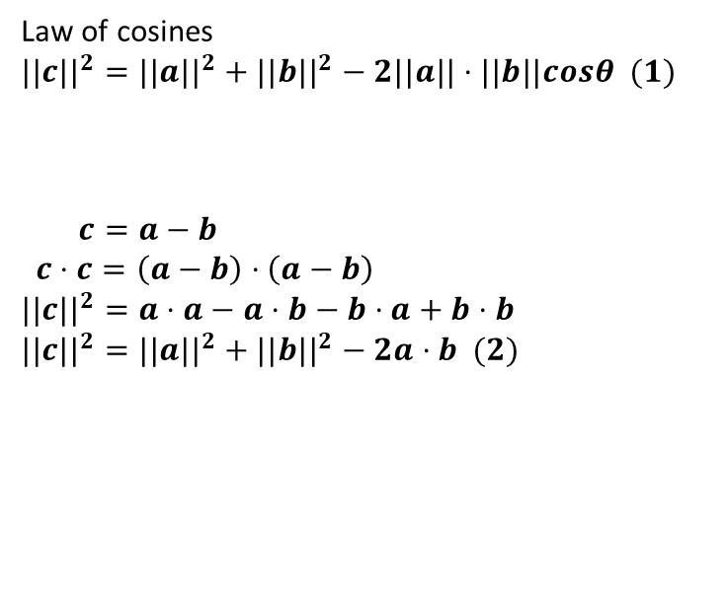
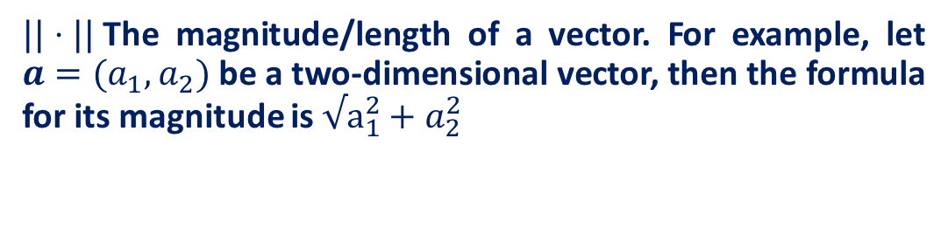





Vectors: Dot Product (inner product)
$$a$$
$$\vec{a}$$
$$c$$
The dot product is also related to the angle between the two vectors
$$\vec{c}$$
$$a⋅b =||a|| ||b||cos θ$$
$$θ$$
$$\vec{b}$$
$$b$$
Law of cosines
$$||c||^{2}=||a||^{2}+||b||^{2}−2||a||⋅||b||cosθ (1)$$
$$c=a−b$$
$c⋅c=\left(a−b\right)⋅\left(a−b\right)$
$$||c||^{2}=a⋅a−a⋅b−b⋅a+b⋅b$$
$$||c||^{2}=||a||^{2}+||b||^{2}−2a⋅b (2)$$
$||⋅||$The magnitude/length of a vector. For example, let $a=(a_{1},a_{2})$ be a two-dimensional vector, then the formula for its magnitude is$√a_{1}^{2}+a_{2}^{2}$

Slide 13

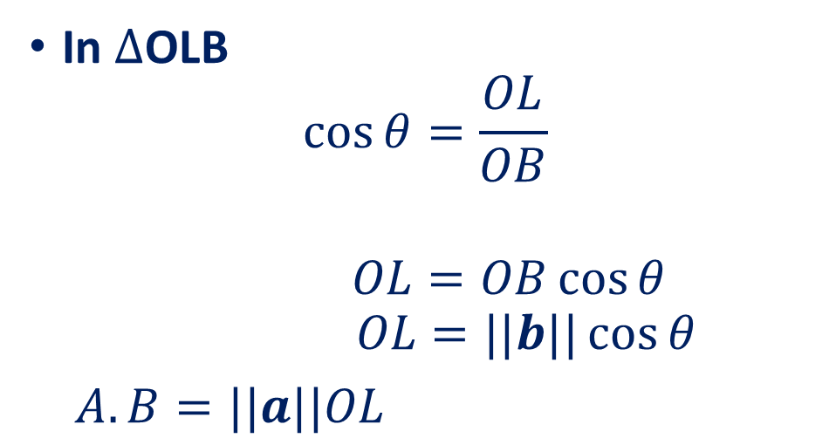









Vectors: Dot Product Geometrical Interpretation
The dot product is also related to the angle between the two vectors
$$a⋅b =||a|| ||b||cos θ$$
In $∆$OLB
$$\cos{θ}=\frac{OL}{OB}$$
$$OL=OB\cos{θ}$$
$$OL=||b||\cos{θ}$$
$A.B=||a||OL$
$$B$$
$$\vec{b}$$
$$θ$$
$$\vec{a}$$
$$O$$
$$\vec{b}\cos{θ}$$
$$A$$
$$L$$
Magnitude of vector A
Projection of vector B on A
$$A.B=0 ⟹A⊥B$$

Slide 14
Dot Product Example: linear feed-forward network
Input neurons’
Firing rates
r₁
Synaptic weights
Insight: for a given input (L2) magnitude, the response is maximized when the input is parallel to the weight vector
r₂
Output neuron’s
firing rate
r_{i}
r_{n}

Slide 15
Multiplication: Outer product
N X 1
1 X M
N X M

Slide 16
Multiplication: Outer product

Slide 17
Multiplication: Outer product

Slide 18
Multiplication: Outer product

Slide 19
Multiplication: Outer product

Slide 20
Multiplication: Outer product

Slide 21
Multiplication: Outer product

Slide 22
Multiplication: Outer product

Slide 23
Matrix times a vector
M X 1
M X N
N X 1

Slide 24
Matrix times a vector: inner product interpretation
Rule: the i^{th} element of y is the dot product of the i^{th} row of W with x

Slide 25
Matrix times a vector: inner product interpretation
Rule: the i^{th} element of y is the dot product of the i^{th} row of W with x

Slide 26
Matrix times a vector: inner product interpretation
Rule: the i^{th} element of y is the dot product of the i^{th} row of W with x

Slide 27
Matrix times a vector: inner product interpretation
Rule: the i^{th} element of y is the dot product of the i^{th} row of W with x

Slide 28
Matrix times a vector: inner product interpretation
Rule: the i^{th} element of y is the dot product of the i^{th} row of W with x

Slide 29
Example of the outer product method

Slide 30
Example of the outer product method
(0,2)
(3,1)

Slide 31
Example of the outer product method
(0,4)
(3,1)

Slide 32
Example of the outer product method
(3,5)

Slide 33
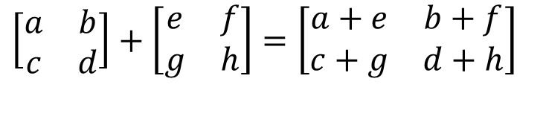
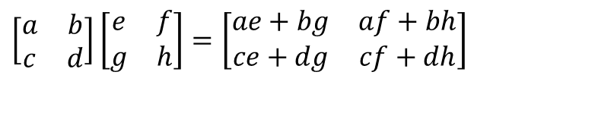
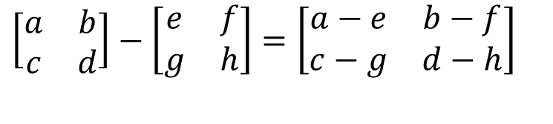
Basic Matrix Operations
Addition, Subtraction, Multiplication: creating new matrices
$$\left[\begin{matrix}a & b \\ c & d\end{matrix}\right]+\left[\begin{matrix}e & f \\ g & h\end{matrix}\right]=\left[\begin{matrix}a+e & b+f \\ c+g & d+h\end{matrix}\right]$$
Just add elements
$$\left[\begin{matrix}a & b \\ c & d\end{matrix}\right]−\left[\begin{matrix}e & f \\ g & h\end{matrix}\right]=\left[\begin{matrix}a−e & b−f \\ c−g & d−h\end{matrix}\right]$$
Just subtract elements
$$\left[\begin{matrix}a & b \\ c & d\end{matrix}\right]\left[\begin{matrix}e & f \\ g & h\end{matrix}\right]=\left[\begin{matrix}ae+bg & af+bh \\ ce+dg & cf+dh\end{matrix}\right]$$
Multiply each row by each column

Slide 34
Product of 2 Matrices
N X P
P X M
N X M
MATLAB: ‘inner matrix dimensions must agree’
Note: Matrix multiplication doesn’t (generally) commute, AB ≠ BA

Slide 35
Matrix times Matrix: by inner products
C_{ij} is the inner product of the i^{th} row with the j^{th} column

Slide 36
Matrix times Matrix: by inner products
C_{ij} is the inner product of the i^{th} row with the j^{th} column

Slide 37
Matrix times Matrix: by inner products
C_{ij} is the inner product of the i^{th} row with the j^{th} column

Slide 38
Matrix times Matrix: by outer products

Slide 39
Matrix times Matrix: by outer products

Slide 40
Matrix times Matrix: by outer products

Slide 41
Matrix times Matrix: by outer products
C is a sum of outer products of the columns of A with the rows of B

Slide 42
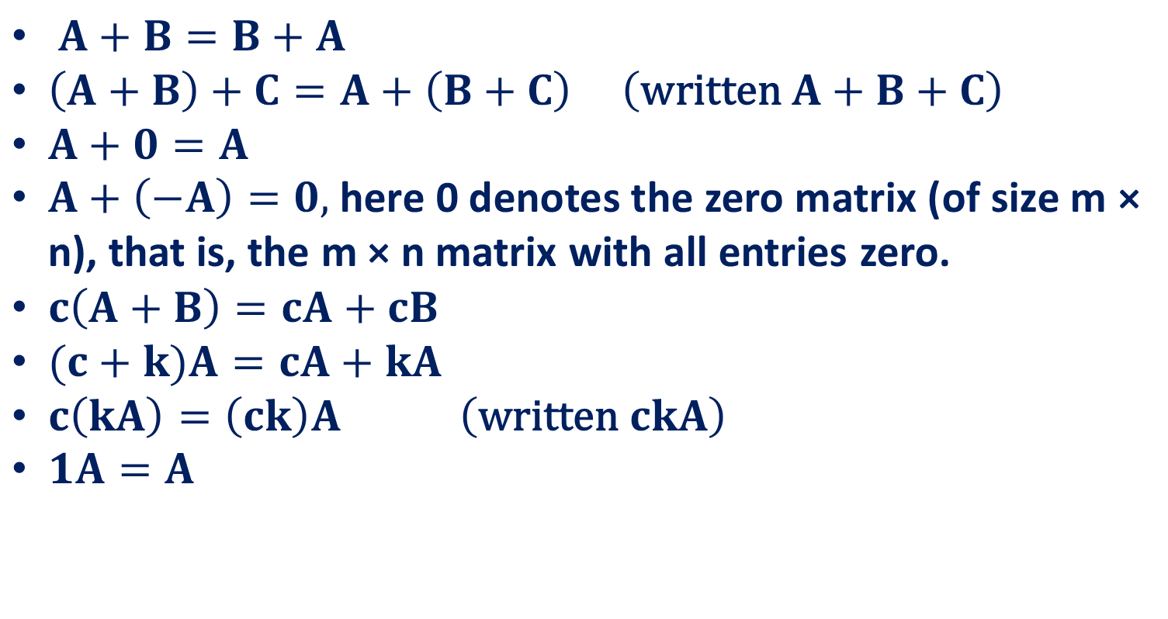
Rules for Matrix Addition and Scalar Multiplication
$A+B=B+A$
$\left(A+B\right)+C=A+\left(B+C\right) \left(\text{written} A+B+C\right)$
$A+0=A$
$A+\left(−A\right)=0,$ here 0 denotes the zero matrix (of size m × n), that is, the m × n matrix with all entries zero.
$c\left(A+B\right)=cA+cB$
$(c+k)A=cA+kA$
$c\left(kA\right)=\left(ck\right)A \left(\text{written} ckA\right)$
$1A=A$

Slide 43
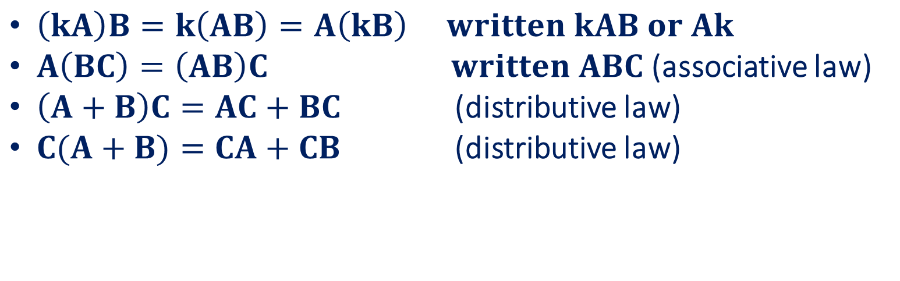
Rules for Matrix Multiplication
Matrix Multiplication Is Not Commutative, AB ≠ BA in General
$\left(kA\right)B=k\left(AB\right)=A\left(kB\right) written kAB or Ak$
$A\left(BC\right)=\left(AB\right)C written ABC$ (associative law)
$\left(A+B\right)C=AC+BC$ (distributive law)
$C(A+B)=CA+CB$ (distributive law)

Slide 44



Transpose of a Matrix
We obtain the transpose of a matrix by writing its rows as columns (or equivalently its columns as rows).
Also note that, if A is the given matrix, then we denote its transpose by A^{T}.
Rules for transposition are
$(A^{T})^{T}=A$
$(A+B)^{T}=A^{T}+B^{T}$
$c(A)^{T}=cA^{T}$
$(AB)^{T}=B^{T}A^{T}$

Slide 45
Equality of Matrices
Definition
Two matrices A = [a_{jk}] and B = [b_{jk}] are equal, written A = B, if and only if (1) they have the same size and (2) the corresponding entries are equal, that is, a₁₁ = b₁₁, a₁₂ = b₁₂, and so on.
Matrices that are not equal are called different. Thus, matrices of different sizes are always different.

Slide 46
Matrix Properties
(A few) special matrices
Matrix transformations & the determinant
Matrices & systems of algebraic equations

Slide 47
Special matrices: diagonal matrix
This acts like scalar multiplication

Slide 48
Special matrices: identity matrix
for all

Slide 49
Special matrices: Inverse Matrix
Some matrices have an inverse, such that: AA⁻¹ = I
Inverse exists only for square matrices that are non-singular
Inversion is tricky: (ABC)⁻¹ = C⁻¹B⁻¹A⁻¹
Derived from non-commutativity property

Slide 50
Symmetric and Skew-Symmetric Matrices.
Symmetric matrices are square matrices whose transpose equals the matrix itself.
A^{T} = A (thus a_{kj} = a_{jk}),
Skew-symmetric matrices are square matrices whose transpose equals minus the matrix.
A^{T} = −A (thus a_{kj} = −a_{jk}), hence a_{jj} = 0).

Slide 51

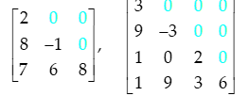
Triangular Matrices.
Upper triangular matrices are square matrices that can have nonzero entries only on and above the main diagonal, whereas any entry below the diagonal must be zero.
Similarly, lower triangular matrices can have nonzero entries only on and below the main diagonal. Any entry on the main diagonal of a triangular matrix may be zero or not.

Slide 52



Scalar matrix
A diagonal matrix whose main diagonal elements are equal to the same scalar
A scalar is defined as a single number or constant
$$\left[\begin{matrix}a & 0 & 0 \\ 0 & a & 0 \\ 0 & 0 & a\end{matrix}\right]$$
$$\left[\begin{matrix}1 & 0 & 0 \\ 0 & 1 & 0 \\ 0 & 0 & 1\end{matrix}\right]$$
$$\left[\begin{matrix}3 & 0 & 0 & 0 \\ 0 & 3 & 0 & 0 \\ 0 & 0 & 3 & 0 \\ 0 & 0 & 0 & 3\end{matrix}\right]$$

Slide 53
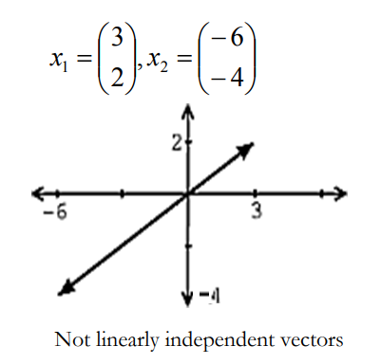
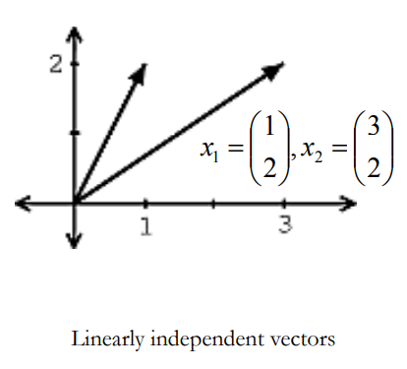
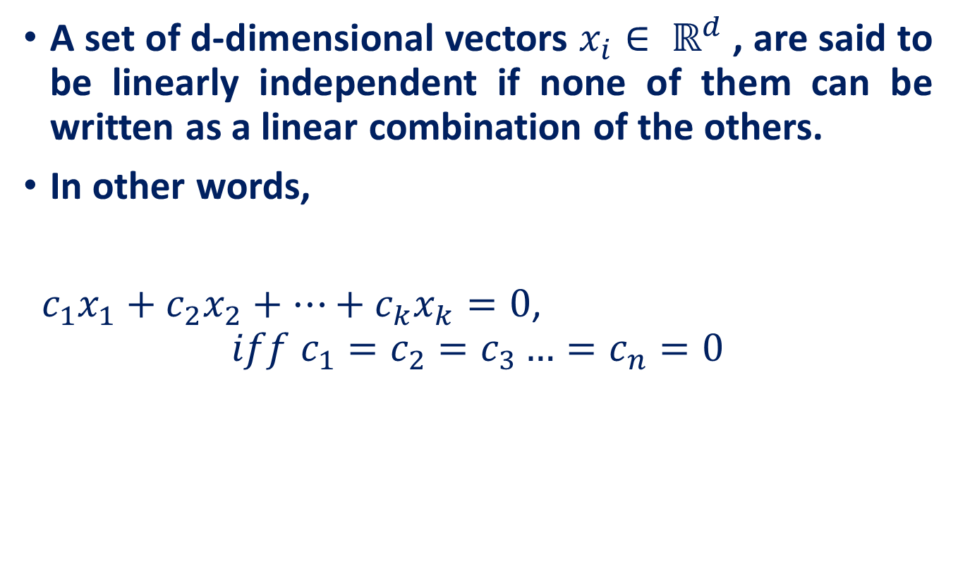
Linear Independence
A set of d-dimensional vectors $x_{i}∈ ℝ^{d}$, are said to be linearly independent if none of them can be written as a linear combination of the others.
In other words,
$c_{1}x_{1}+c_{2}x_{2}+…+c_{k}x_{k}=0$,
$$iff c_{1}=c_{2}=c_{3}…=c_{n}=0$$

Slide 54
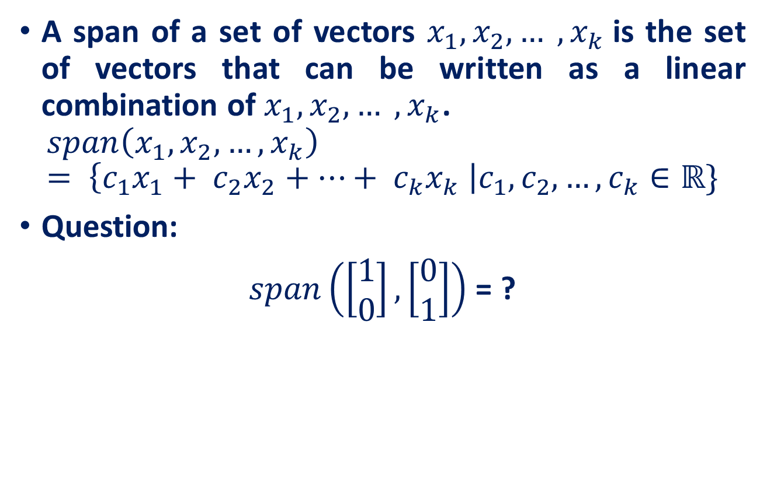
Span
A span of a set of vectors $x_{1}, x_{2}, … , x_{k}$is the set of vectors that can be written as a linear combination of $x_{1}, x_{2}, … , x_{k}$.
$$span\left(x_{1}, x_{2},…, x_{k}\right)= \left\{c_{1}x_{1}+ c_{2}x_{2}+…+ c_{k}x_{k} \right|c_{1},c_{2},…,c_{k}∈ℝ\}$$
Question:
$span\left(\left[\begin{matrix}1 \\ 0\end{matrix}\right], \left[\begin{matrix}0 \\ 1\end{matrix}\right]\right)$ = ?

Slide 55
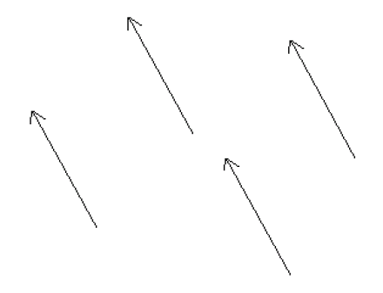
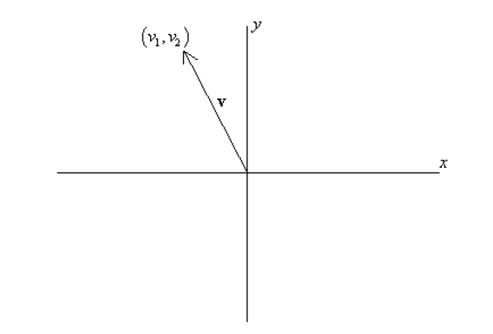
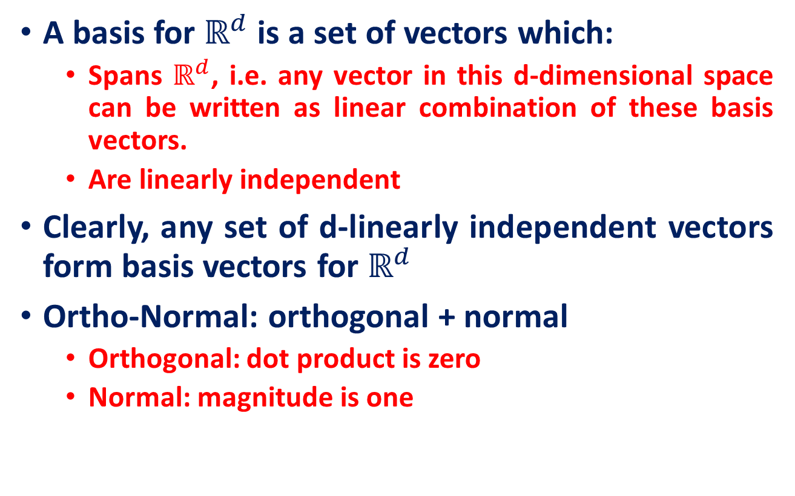


Bases & Orthonormal Bases
A basis for $ℝ^{d}$ is a set of vectors which:
Spans $ℝ^{d}$, i.e. any vector in this d-dimensional space can be written as linear combination of these basis vectors.
Are linearly independent
Clearly, any set of d-linearly independent vectors form basis vectors for $ℝ^{d}$
Ortho-Normal: orthogonal + normal
Orthogonal: dot product is zero
Normal: magnitude is one
vs
$$x={\left[\begin{matrix}1 & 0 & 0\end{matrix}\right]}^{T} \\ y={\left[\begin{matrix}0 & 1 & 0\end{matrix}\right]}^{T} \\ z={\left[\begin{matrix}0 & 0 & 1\end{matrix}\right]}^{T}$$
$$x⋅y=0 \\ x⋅z=0 \\ y⋅z=0$$

Slide 56
Determinants
Given a square matrix A its determinant is a real number associated with the matrix.
The determinant of A is written:
det(A) or |A|
For a 2x2 matrix, the definition is
a
b
a
b
det = = ad - bc
c
d
c
d
Source- 6502 : Mathematics for Engineers 2, James Burnett, Department of Mathematics, University College London

Slide 57
Determinants 2x2 examples
1
2
1
2
det = = (1)(4) – (2)(3) = -2
3
4
3
4
-5
2
-5
2
det = = (-5)(0) – (2)(-2) = 4
-2
0
-2
0
1
2
1
2
det = = (1)(4) – (2)(2) = 0
2
4
2
4

Slide 58
Determinants
To define det(A) for larger matrices, we will need the definition of a minor M_{ij}
The minor M_{ij} of a matrix A is the matrix formed by removing the ith row and the jth column of A
M₁₁: remove row 1, col 1
1
1
-2
A =
-1
2
3
2
3
M₁₁ =
2
7
0
7
0

Slide 59
Determinants
To define det(A) for larger matrices, we will need the definition of a minor M_{ij}
The minor M_{ij} of a matrix A is the matrix formed by removing the ith row and the jth column of A
M₁₂ : remove row 1, col 2
1
1
-2
A =
-1
2
3
-1
3
M₁₂ =
2
7
0
2
0

Slide 60
Determinants
To define det(A) for larger matrices, we will need the definition of a minor M_{ij}
The minor M_{ij} of a matrix A is the matrix formed by removing the ith row and the jth column of A
M₁₃ : remove row 1, col 3
1
1
-2
A =
-1
2
3
-1
2
M₁₃ =
2
7
0
2
7

Slide 61
Determinants
To define det(A) for larger matrices, we will need the definition of a minor M_{ij}
The minor M_{ij} of a matrix A is the matrix formed by removing the ith row and the jth column of A
M₂₁ : remove row 2, col 1
1
1
-2
A =
-1
2
3
1
-2
M₂₁ =
2
7
0
7
0

Slide 62
The formula for a 3x3 matrix
a₁₁
a₁₂
a₁₃
For a matrix
A =
a₂₁
a₂₂
a₂₃
a₃₁
a₃₂
a₃₃
Its determinant is given by
|A| = a₁₁|M₁₁| - a₁₂|M₁₂| + a₁₃|M₁₃|
From the formula for a 2x2 matrix:
a₂₂
a₂₃
|M₁₁|= = a₂₂a₃₃ - a₂₃a₃₂
a₃₂
a₃₃

Slide 63
The formula for a 3x3 matrix
a₁₁
a₁₂
a₁₃
For a matrix
A =
a₂₁
a₂₂
a₂₃
a₃₁
a₃₂
a₃₃
Its determinant is given by
|A| = a₁₁|M₁₁| - a₁₂|M₁₂| + a₁₃|M₁₃|
From the formula for a 2x2 matrix:
a₂₁
a₂₃
|M₁₂|= = a₂₁a₃₃ - a₂₃a₃₁
a₃₁
a₃₃

Slide 64
The formula for a 3x3 matrix
a₁₁
a₁₂
a₁₃
For a matrix
A =
a₂₁
a₂₂
a₂₃
a₃₁
a₃₂
a₃₃
Its determinant is given by
|A| = a₁₁|M₁₁| - a₁₂|M₁₂| + a₁₃|M₁₃|
From the formula for a 2x2 matrix:
a₂₁
a₂₂
|M₁₃|= = a₂₁a₃₂ - a₃₁a₂₂
a₃₁
a₃₂

Slide 65
3x3 Example
1
1
-2
A =
-1
2
3
2
7
0
|A| = 1x|M₁₁| - 1x|M₁₂| + (-2)x|M₁₃|
2
3
-1
3
-1
2
|A|= 1x - 1x + (-2)
7
0
2
0
2
7
= 1x(-21) -1x(-6) +(-2)x(-11) = 7

Slide 66
The formula for a 3x3 matrix
a₁₁
a₁₂
a₁₃
For the matrix
A =
a₂₁
a₂₂
a₂₃
a₃₁
a₃₂
a₃₃
We used the top row to calculate the determinant:
|A| = a₁₁|M₁₁| - a₁₂|M₁₂| + a₁₃|M₁₃|
However, we could equally have used any row of the matrix and performed a similar calculation

Slide 67
The formula for a 3x3 matrix
a₁₁
a₁₂
a₁₃
For the matrix
A =
a₂₁
a₂₂
a₂₃
a₃₁
a₃₂
a₃₃
Using the top row:
|A| = a₁₁|M₁₁| - a₁₂|M₁₂| + a₁₃|M₁₃|
Using the second row
|A| = -a₂₁|M₂₁| + a₂₂|M₂₂| - a₂₃|M₂₃|
Using the third row
|A| = a₃₁|M₃₁| - a₃₂|M₃₂| + a₃₃|M₃₃|

Slide 68
The formula for a 3x3 matrix
|A| = a₁₁|M₁₁| - a₁₂|M₁₂| + a₁₃|M₁₃|
= -a₂₁|M₂₁| + a₂₂|M₂₂| - a₂₃|M₂₃|
= a₃₁|M₃₁| - a₃₂|M₃₂| + a₃₃|M₃₃|
Notice the changing signs depending on what row we use:
+
-
+
-
+
-
+
-
+

Slide 69
The formula for a 3x3 matrix
Equally, we could have used any column as long as we follow the signs pattern
+
-
+
a₁₁
a₁₂
a₁₃
-
+
-
A =
a₂₁
a₂₂
a₂₃
+
-
+
a₃₁
a₃₂
a₃₃
E.g. using the first column:
|A| = a₁₁|M₁₁| - a₂₁|M₂₁| + a₃₁|M₃₁|

Slide 70
The formula for a 3x3 matrix
This choice sometimes makes it a bit easier to calculate determinants. e.g.
1
1
-2
A =
0
2
3
0
1
1
Using the first row:
2
3
0
3
0
2
|A|= 1x - 1x + (-2) x
1
1
0
1
0
1
= 1x(-1) -1x(0) + (-2)x(0) = -1

Slide 71
The formula for a 3x3 matrix
This choice sometimes makes it a bit easier to calculate determinants. e.g.
1
1
-2
A =
0
2
3
0
1
1
However, using the first column:
2
3
|A|= 1x - 0 + 0 = 1x(-1) = -1
1
1

Slide 72
A general formula for determinants
For a 4x4 matrix we add up minors like the 3x3 case, and again use the same signs pattern
Notice that if we think of the signs pattern as a matrix, then it can be written as (-1)^{i+j}
+
-
+
-
-
+
-
+
+
-
+
-
-
+
-
+

Slide 73


A general formula for determinants
For a nxn matrix A=(a_{ij}) the co-factors of A are defined by
C_{ij}:= (-1)^{i+j}|M_{ij}|
The determinant of A is given by the formula
|A|= a_{ij} C_{ij} for any j=1,2,...,n
$$\sum_{i=1}^{n}{}$$
Or,
|A|= a_{ij} C_{ij} for any i=1,2,...,n
$$\sum_{j=1}^{n}{}$$

Slide 74
A general formula for determinants
a
b
A =
Consider the 2x2 matrix
c
d
Add the second column to the first and calculate the determinant:
a+b
b
= (a+b)d –b(c+d)
c+d
d
= (ad+bd) –(bc+bd)
= (ad–bc)
=|A|

Slide 75
A trick for calculating determinants
In fact if you replace any column of a matrix by the original column + a multiple of any other column the determinant is unchanged.
Similarly, if you replace any row of a matrix by the original row + a multiple of any other row the determinant is unchanged.
WARNING: adding one row or column to itself will in general change the determinant

Slide 76
A trick for calculating determinants
Example:
1
1
1
1
0
1
A =
a
b
c
C₂
C₂-C₁
a
b-a
c
b+c
a+c
a+b
b+c
a-b
a+b
So, using the top row:
C₃
C₃-C₁
| A | = (b-a)(a-c) – (c-a)(a-b)
= ba-a²+ac-bc
-(ac-bc -a²+ab)
= 0
1
0
0
a
b-a
c-a
b+c
a-b
a-c

Slide 77
More determinant properties
If we take the transpose of a matrix, its determinant is unchanged: |A| = |A^{T}|
For diagonal or upper triangular or lower triangular matrices, the determinant is the product of the leading diagonal entries:
a₁₁
0
0
a₁₁
a₁₂
a₁₃
a₁₁
0
0
0
a₂₂
0
=
0
a₂₂
a₂₃
=
a₂₁
a₂₂
0
= a₁₁a₂₂a₃₃
0
0
a₃₃
0
0
a₃₃
a₃₁
a₃₂
a₃₃

Slide 78
More determinant properties
Multiplying a whole row (or column) by k multiplies the determinant by k.
If a matrix is nxn then multiplying the matrix by k is the same as multiplying n rows by k. Hence, the determinant is multiplied by k^{n}.
ka
kb
a
b
ka
kb
a
b
= k
= k²
c
d
c
d
kc
kd
c
d

Slide 79
More determinant properties
If we swap two rows (or two columns), the determinant changes by a factor of (-1):
If an entire row or column is zero, the determinant is zero
c
d
a
b
= (-1)
a
b
c
d
1
0
-1
-1
0
7
2
4
5
=
3
0
5
= 0
0
0
0
1
0
4

Slide 80
More determinant properties
The determinant of a product is the product of determinants:
|A B| = |A| |B|
Example
1
2
1
2
A =
B =
|A| = -2, |B| = 2
3
4
-1
0
-1
2
A B =
So, |A B| = -4 = (-2)(2) = |A||B|
-1
6

Slide 81


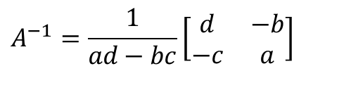
Determinant of a Matrix: Applications
Used for inversion
If det(A) = 0, then A has no inverse
Determinants can be used to see if a system of n linear equations in n variables has a unique solution.
For more, please refer: “Several Applications of Determinants”, E. Ulrychov´a
$$A=\left[\begin{matrix}a & b \\ c & d\end{matrix}\right]$$
$$A^{−1}=\frac{1}{ad−bc}\left[\begin{matrix}d & −b \\ −c & a\end{matrix}\right]$$
$$\det{(}A)=ad−bc$$

Slide 82
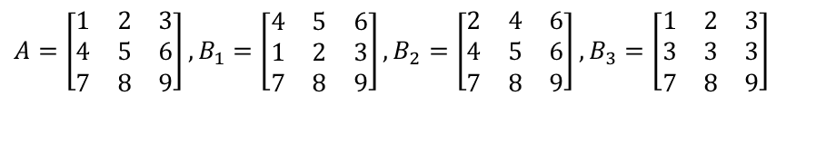

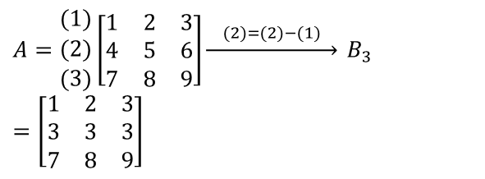
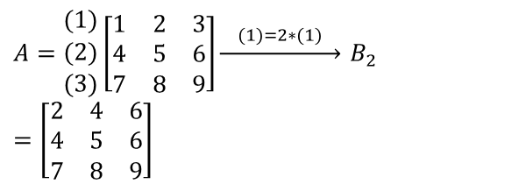
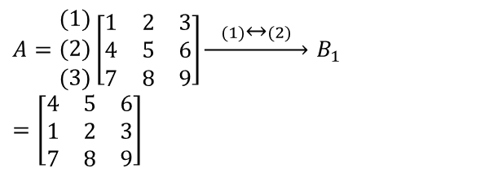
Rank of a Matrix
.
Definition of row equivalence:
A matrix B is row equivalent to a matrix A if B result from A via elementary row operations.
Let
Since
$$A=\left[\begin{matrix}1 & 2 & 3 \\ 4 & 5 & 6 \\ 7 & 8 & 9\end{matrix}\right], B_{1}=\left[\begin{matrix}4 & 5 & 6 \\ 1 & 2 & 3 \\ 7 & 8 & 9\end{matrix}\right], B_{2}=\left[\begin{matrix}2 & 4 & 6 \\ 4 & 5 & 6 \\ 7 & 8 & 9\end{matrix}\right], B_{3}=\left[\begin{matrix}1 & 2 & 3 \\ 3 & 3 & 3 \\ 7 & 8 & 9\end{matrix}\right]$$
$$A=\begin{matrix}(1) \\ (2) \\ (3)\end{matrix}\left[\begin{matrix}1 & 2 & 3 \\ 4 & 5 & 6 \\ 7 & 8 & 9\end{matrix}\right]\underset{→}{ (1)↔(2) } B_{1}=\left[\begin{matrix}4 & 5 & 6 \\ 1 & 2 & 3 \\ 7 & 8 & 9\end{matrix}\right]$$
$$A=\begin{matrix}(1) \\ (2) \\ (3)\end{matrix}\left[\begin{matrix}1 & 2 & 3 \\ 4 & 5 & 6 \\ 7 & 8 & 9\end{matrix}\right]\underset{→}{ (1)=2∗(1) } B_{2}=\left[\begin{matrix}2 & 4 & 6 \\ 4 & 5 & 6 \\ 7 & 8 & 9\end{matrix}\right]$$
$$A=\begin{matrix}(1) \\ (2) \\ (3)\end{matrix}\left[\begin{matrix}1 & 2 & 3 \\ 4 & 5 & 6 \\ 7 & 8 & 9\end{matrix}\right]\underset{→}{ (2)=(2)−(1) } B_{3}=\left[\begin{matrix}1 & 2 & 3 \\ 3 & 3 & 3 \\ 7 & 8 & 9\end{matrix}\right]$$
$$B_{1},B_{2},B_{3}$$
are row equivalent to A

Slide 83
Rank of a Matrix
“row-rank of a matrix” counts the max. number of linearly independent rows.
“column-rank of a matrix” counts the max. number of linearly independent columns.
One application: Given a large system of linear equations, count the number of essentially different equations.
The number of essentially different equations is just the row-rank of the augmented matrix.
Source: ENGG2013, Advanced Engineering Math. Kenneth Shum

Slide 84
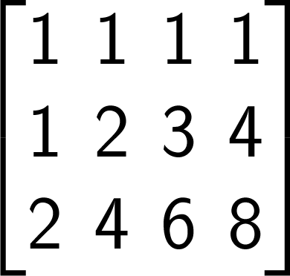
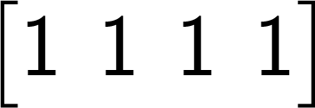
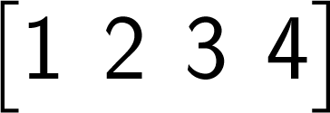
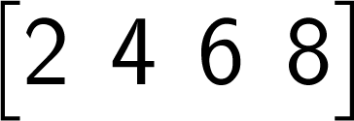
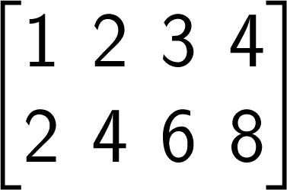
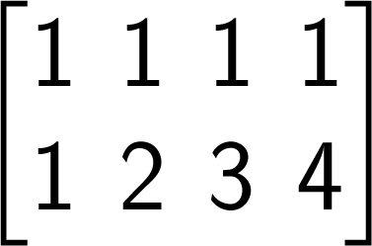
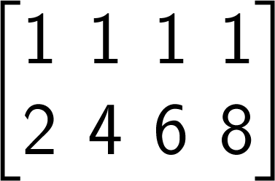
Evaluating the row-rank by definition
Linearly independent
Linearly independent
Linearly independent
Linearly dependent
Linearly independent
Linearly independent
Linearly dependent
⇒ Row-Rank = 2

Slide 85
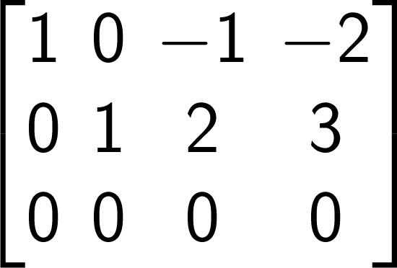
Calculation of row-rank via RREF
Row reductions
Row-rank = 2
Row-rank = 2
Because row reductions do not affect the number of linearly independent rows

Slide 86





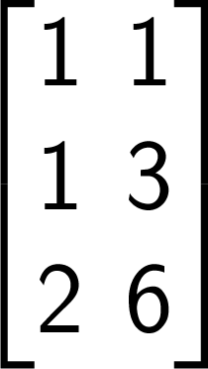
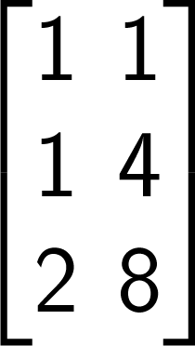
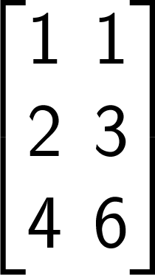
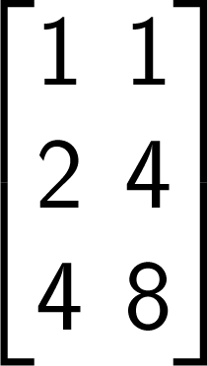
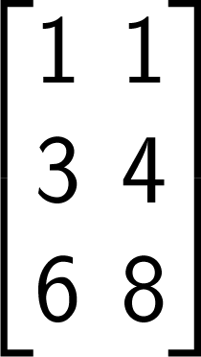
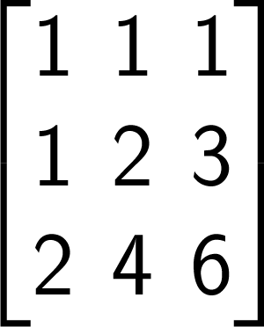
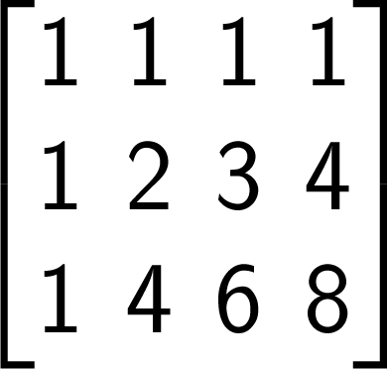
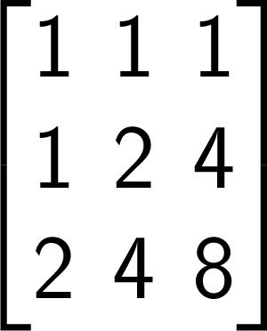
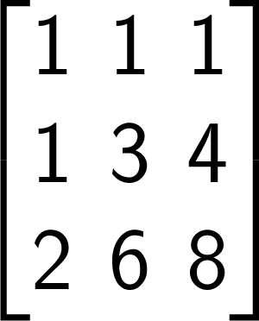

Calculation of column-rank by definition
List all combinations of columns
⇒ Column-Rank = 2
Linearly independent??
Y
Y
Y
Y
Y
Y
Y
Y
Y
Y
N
N
N
N
N

Slide 87
Theorem
Given any matrix, its row-rank and column-rank are equal.
In view of this property, we can just say the “rank of a matrix”. It means either the row-rank of column-rank.

Slide 88




Why row-rank = column-rank?
If some column vectors are linearly dependent, they remain linearly dependent after any elementary row operation
For example, are linearly dependent

Slide 89
Why row-rank = column-rank?
Any row operation does not change the column- rank.
By the same argument, apply to the transpose of the matrix, we conclude that any column operation does not change the row-rank as well.

Slide 90

Why row-rank = column-rank?
Apply row reductions. row-rank and column-rank do not change.
Apply column reductions. row-rank and column-rank do not change.
The top-left corner is an identity matrix.
The row-rank and column-rank of this “normal form” is certainly the size of this identity submatrix,
and are therefore equal.

Slide 91

Pivot/Leading entry
Let A be a non-zero matrix. Then, in each non-zero row of A, the left most non-zero entry is called a pivot/leading entry.
The column containing the pivot is called a pivotal column.
For example, the entries $a_{12}$ and $a_{23}$ are pivots in
$$A=\left[\begin{matrix}0 & 3 & 4 & 2 \\ \begin{aligned}0 \\ 0\end{aligned} & \begin{aligned}0 \\ 0\end{aligned} & \begin{aligned}0 \\ 2\end{aligned} & \begin{aligned}0 \\ 1\end{aligned}\end{matrix}\right]$$

Slide 92


Row Echelon Form (REF) of a Matrix
A matrix is in row echelon form if the following conditions are satisfied:
if the zero rows are at the bottom
if the pivot of the (i + 1)-th row, if it exists, comes to the right of the pivot of the i-th row, i.e., the column subscript of the leading non-zero entries increases as the row subscript increases.
if the entries below the pivot in a pivotal column are 0
Some texts add the condition that the leading coefficient must be 1.
In Row Echelon Form
Not In Row Echelon Form
Source: Linear Algebra through Matrices, Arbind K Lal and Sukant Pati

Slide 93

Elementary Row Operations on a Matrix
A combination of the following operations will transform a matrix to row echelon form:
Interchange any two rows.
Notation: $R_{ij}$ indicates interchanging the i-th and j-th rows
Multiply all elements of a row by a nonzero real number.
Notation: ${kR}_{i}$ indicates multiplying the i-th row by k
Add a multiple of one row to any other row.
Notation: ${kR}_{i}$ + $R_{j}$ indicates adding k times the i-th row to the j-th row

Slide 94







Example: Finding the REF
$$\left[\begin{matrix}1 & −1 & 2 & −3 \\ 2 & 1 & −1 & 0 \\ −1 & 2 & −3 & 7\end{matrix}\right]$$
$$−2R_{1}+R_{2}$$
Input Matrix:
$$\left[\begin{matrix}1 & −1 & 2 & −3 \\ 0 & 3 & −5 & 6 \\ −1 & 2 & −3 & 7\end{matrix}\right]$$
$$R_{1}+R_{3}$$
$$\left[\begin{matrix}1 & −1 & 2 & −3 \\ 0 & 1 & −1 & 4 \\ 0 & 3 & −5 & 6\end{matrix}\right]$$
$$R_{23}$$
$$\left[\begin{matrix}1 & −1 & 2 & −3 \\ 0 & 3 & −5 & 6 \\ 0 & 1 & −1 & 4\end{matrix}\right]$$
Source: http://www.northlandprep.org/wp-content/uploads/2012/03/PC-7.3b.ppt

Slide 95





Example: Finding the REF
$$\left[\begin{matrix}1 & −1 & 2 & −3 \\ 0 & 1 & −1 & 4 \\ 0 & 3 & −5 & 6\end{matrix}\right]$$
$$−3R_{2}+R_{3}$$
$$\left[\begin{matrix}1 & −1 & 2 & −3 \\ 0 & 1 & −1 & 4 \\ 0 & 0 & −2 & −6\end{matrix}\right]$$
$$−\frac{1}{2}R_{3}$$
$$\left[\begin{matrix}1 & −1 & 2 & −3 \\ 0 & 1 & −1 & 4 \\ 0 & 0 & 1 & 3\end{matrix}\right]$$

Slide 96



Practice
What elementary row operations applied to
$$\left[\begin{matrix}−2 & 1 & −1 & 2 \\ 1 & −2 & 3 & 0 \\ 3 & 1 & −1 & 2\end{matrix}\right]$$
$$R_{1}=2R_{2}+R_{1}$$
$$\left[\begin{matrix}0 & −3 & 5 & 2 \\ 1 & −2 & 3 & 0 \\ 3 & 1 & −1 & 2\end{matrix}\right]$$

Slide 97



Practice
What elementary row operations applied to
$$R_{3}=\frac{1}{4}R_{3}$$
$$\left[\begin{matrix}−2 & 1 & −1 & 2 \\ 1 & −2 & 3 & 0 \\ 3 & 1 & −1 & 2\end{matrix}\right]$$
$$\left[\begin{matrix}−2 & 1 & −1 & 2 \\ 1 & −2 & 3 & 0 \\ 0.75 & 0.25 & −0.25 & 0.5\end{matrix}\right]$$

Slide 98







Practice
Find a row echelon form for the given matrix.
$$\left[\begin{matrix}1 & 2 & −3 \\ −3 & −6 & 10 \\ −2 & −4 & 7\end{matrix}\right]$$
$$\left[\begin{matrix}1 & 2 & −3 \\ 0 & 0 & 1 \\ −2 & −4 & 7\end{matrix}\right]$$
$$R_{2}=3R_{1}+R_{2}$$
$$R_{3}=2R_{1}+R_{3}$$
$$\left[\begin{matrix}1 & 2 & −3 \\ 0 & 0 & 1 \\ 0 & 0 & 0\end{matrix}\right]$$
$$R_{3}=−1R_{2}+R_{3}$$
$$\left[\begin{matrix}1 & 2 & −3 \\ 0 & 0 & 1 \\ 0 & 0 & 1\end{matrix}\right]$$

Slide 99
Reduced Row Echelon Form
It is possible to continue applying elementary row operations to a REF matrix until every column that has a leading non-zero has 0’s elsewhere. This is the Reduced Row Echelon Form (RREF) of the matrix.

Slide 100









Example: Finding the RREF
$$\left[\begin{matrix}3 & 7 & −11 & \\ 1 & 2 & −3 & \\ 4 & 9 & −13 & \end{matrix}\right]$$
$$R_{1}=−3R_{2}+R_{1}$$
$$\left[\begin{matrix}0 & 1 & −2 & \\ 1 & 2 & −3 & \\ 4 & 9 & −13 & \end{matrix}\right]$$
Input Matrix:
$$R_{3}=−4R_{2}+R_{3}$$
$$\left[\begin{matrix}0 & 1 & −2 & \\ 1 & 2 & −3 & \\ 0 & 1 & −1 & \end{matrix}\right]$$
$$\left[\begin{matrix}1 & 2 & −3 & \\ 0 & 1 & −2 & \\ 0 & 0 & 1 & \end{matrix}\right]$$
$$R_{12}$$
$$\left[\begin{matrix}0 & 1 & −2 & \\ 1 & 2 & −3 & \\ 0 & 0 & 1 & \end{matrix}\right]$$
$$R_{3}=−R_{1}+R_{3}$$

Slide 101







Example: Finding the RREF
$$\left[\begin{matrix}1 & 2 & −3 & \\ 0 & 1 & −2 & \\ 0 & 0 & 1 & \end{matrix}\right]$$
$$R_{1}=−2R_{2}+R_{1}$$
$$\left[\begin{matrix}1 & 0 & 1 & \\ 0 & 1 & −2 & \\ 0 & 0 & 1 & \end{matrix}\right]$$
$$R_{1}=−R_{3}+R_{1}$$
$$\left[\begin{matrix}1 & 0 & 0 & \\ 0 & 1 & 0 & \\ 0 & 0 & 1 & \end{matrix}\right]$$
$$R_{2}=2R_{3}+R_{2}$$
$$\left[\begin{matrix}1 & 0 & 0 & \\ 0 & 1 & −2 & \\ 0 & 0 & 1 & \end{matrix}\right]$$

Slide 102



Practice
$$\left[\begin{matrix}2 & −1 & 1 & −3 & 5 \\ 1 & 2 & 3 & −1 & 16 \\ 7 & −3 & −2 & 2 & −11 \\ −1 & 1 & −1 & 5 & −9\end{matrix}\right]$$
$$\left[\begin{matrix}1 & 0 & 0 & 0 & 2 \\ 0 & 1 & 0 & 0 & 7 \\ 0 & 0 & 1 & 0 & −1 \\ 0 & 0 & 0 & 1 & −3\end{matrix}\right]$$
RREF: List all the elementary row operations
Consider last column as an additional column. Your actual matrix is $4×4$
All the elementary operation will also be performed on last column

Slide 103

REF
Theorem. Every matrix is row equivalent to a matrix in row echelon form.
Proof
Select a non-zero entry furthest to the left in the matrix.
If this entry is not in the first column, this means that the matrix consists entirely of zeros to the left of this entry, and we can forget about them.
So suppose this non-zero entry is in the first column. After an interchange of rows, we can find an equivalent matrix such that the upper left-hand corner is not O.

Slide 104

REF
Say the matrix is
and $a_{11}≠0$.
We multiply the first row by a $\frac{a_{21}}{a_{11}}$ and subtract from the second row. Similarly, for other rows.
Then we obtain a matrix which has zeros in the first column except for all.
Thus the original matrix is row equivalent to a matrix of the form

Slide 105


REF
Thus, the original matrix is row equivalent to a matrix of the form
We then repeat the procedure with the smaller matrix
We can continue until the matrix is In row echelon form

Slide 106
Systems of equations
A system of equations is a group of two or more equations.
To solve a system of equations means to find values for the variables that satisfy all of the equations in the system.
Systems of equations can involve any number of equations and variables.

Slide 107

Linear equation
A linear equation is an equation that may be put in the form
$$a_{1}x_{1}+a_{2}x_{2}+…+a_{n}x_{n}+b=0$$
where $x_{1}$, $x_{2}$, $…$, $x_{n}$are the variables (or unknowns), and $b, a_{1}$, $a_{2}$, $…$, $a_{n}$ are the coefficients, which are often real numbers.

Slide 108

System of linear equations
Examples of linear systems
Suppose $a, b ∈ R$. Consider the system $ax = b$in the variable $x$. if
$a≠0$then the system has a unique solution $x =\frac{b}{a}$
$a = 0$and
$b≠0$then the system has no solution.
$b = 0$then the system has infinite number of solutions, namely all $x ∈ R$.

Slide 109

System of linear equations
System of two linear equations in two variables may be written in the general form
$$a_{1}x+b_{1}y=c_{1}$$
$$a_{2}x+b_{2}y=c_{2}$$
where $a_{1}$, $a_{2}$, $b_{1}$, $b_{2}$, $c_{1}$, and $c_{2}$ are real numbers and $\left(a_{1},b_{1}\right), \left(b_{1},b_{2}\right)≠0$, i.e., neither $a_{1}$ and $b_{1}$ nor $a_{2}$ and $b_{2}$ are both zero.
Graph of each equation in the system is a straight line in the plane, so that geometrically, the solution to the system is the point(s) of intersection of the two straight lines $ℓ_{1}$ and $ℓ_{2}$, represented by the first and second equations of the system.

Slide 110
System of linear equations
Given the two straight lines L₁ and L₂, one and only one of the following may occur:
1. L₁ and L₂ intersect at exactly one point.
y
L₁
Unique solution
(x₁, y₁)
y₁
(x₁, y₁)
x₁
x
L₂
Source:http://www.shsu.edu/ldg005/data/mth199/chapter5.ppt

Slide 111
System of linear equations
Given the two straight lines L₁ and L₂, one and only one of the following may occur:
2. L₁ and L₂ are coincident.
y
L_{1,} , L₂
Infinitely many solutions
x

Slide 112
System of linear equations
Given the two straight lines L₁ and L₂, one and only one of the following may occur:
3. L₁ and L₂ are parallel.
y
L_{1,}
L₂
No
solutions
x

Slide 113

System of linear equations
Unique Solution $(a_{1}b_{2} − a_{2}b_{1}≠0)$: The linear system $x − y = 3$and $2x + 3y$has $(x,y) = (4,1)$ as the unique solution.
No Solution $(a_{1}b_{2} − a_{2}b_{1}=0$ but $a_{1}c_{2} − a_{2}c_{1}≠0$): The linear system $x + 2y = 1$and $2x+ 4y = 3$represent a pair of parallel lines which have no point of intersection.
Infinite Number of Solutions $(a_{1}b_{2} − a_{2}b_{1}=0$ and $a_{1}c_{2} − a_{2}c_{1}=0$): The linear system $x + 2y = 1$and $2x+ 4y =2$represent the same line.
If the linear system $ax + by = c$has
$(a, b) = (0, 0)$and $c≠ 0$ then $ax + by = c$has no solution.
$(a, b, c) = (0, 0, 0$) then $ax+by = c$has infinite number of solutions, namely whole of $ℝ^{2}$.

Slide 114

Different ways of looking at the linear system
There are three ways of looking at the linear system Ax = b
Point of intersection of planes
Vector sum approach
Matrix multiplication approach.
For the linear system $x − y = 3$and $2x + 3y$
$(x,y) = (4,1)$corresponds to the point of intersection of the corresponding two lines

Slide 115

Different ways of looking at the linear system
There are three ways of looking at the linear system Ax = b
Point of intersection of planes
Vector sum approach
Matrix multiplication approach.
For the linear system $x − y = 3$and $2x + 3y$
Using matrix multiplication, the given system equals
Ax = b, where $A=\left[\begin{matrix}1 & −1 \\ 2 & 3\end{matrix}\right]$, $x= \left[\begin{matrix}x \\ y\end{matrix}\right]$ and $b= \left[\begin{matrix}3 \\ 11\end{matrix}\right]$.
So the solution is $x=A^{−1}b=\frac{1}{5}$ $\left[\begin{matrix} 3 & 1 \\ −2 & 1\end{matrix}\right]$ $\left[\begin{matrix}3 \\ 11\end{matrix}\right]$= $\left[\begin{matrix}4 \\ 1\end{matrix}\right]$

Slide 116

Different ways of looking at the linear system
There are three ways of looking at the linear system Ax = b
Point of intersection of planes
Vector sum approach
Matrix multiplication approach.
For the linear system $x − y = 3$and $2x + 3y$
Re-writing $Ax = b$ as, $\left[\begin{matrix}1 \\ 2\end{matrix}\right]x+\left[\begin{matrix}−1 \\ 3\end{matrix}\right]y=\left[\begin{matrix}3 \\ 11\end{matrix}\right]$ gives us $4\left[\begin{matrix}1 \\ 2\end{matrix}\right]+1\left[\begin{matrix}−1 \\ 3\end{matrix}\right]=\left[\begin{matrix}3 \\ 11\end{matrix}\right]$. This corresponds to addition of vectors in the Euclidean plane.

Slide 117

System of linear equations
A system of $m$ linear equations in $n$ variables $x_{1}, x_{2}, …, x_{n}$ is a set of equations of the form
$$a_{11}x_{1}+a_{12}x_{2}+…+a_{1n}x_{n}=b_{1}$$
$$a_{21}x_{1}+a_{22}x_{2}+…+a_{2n}x_{n}=b_{2}$$
$$a_{31}x_{1}+a_{32}x_{2}+…+a_{3n}x_{n}=b_{3}$$
$⋮$ $⋮$
$$a_{m1}x_{1}+a_{m2}x_{2}+…+a_{mn}x_{n}=b_{m}$$
where for $1 ≤ i ≤ m$and $1 ≤ j ≤ n$; $a_{ij} , b_{i} ∈ R$
The linear system given above is called homogeneous if $b_{1} = 0 = b_{2} = · · · = b_{m}$and non-homogeneous, otherwise.

Slide 118

System of linear equations
Let
$A=\left[\begin{matrix}a_{11} & a_{12} & ⋯ & a_{1n} \\ a_{21} & a_{22} & … & a_{2n} \\ ⋮ & ⋮ & ⋱ & ⋮ \\ a_{m1} & a_{m2} & ⋯ & a_{mn}\end{matrix}\right]$, $x=\left[\begin{matrix}x_{1} \\ \begin{aligned}x_{2} \\ ⋮ \\ x_{n}\end{aligned}\end{matrix}\right]$, and $b=\left[\begin{matrix}b_{1} \\ \begin{aligned}b_{2} \\ ⋮ \\ b_{n}\end{aligned}\end{matrix}\right]$
Then, the system of $m$ linear equations in $n$ variables $x_{1}, x_{2}, …, x_{n}$ can be re-written as $Ax=b$, where A is called coefficient matrix and the block matrix [A b] is called the augmented matrix

Slide 119

System of linear equations
Consider a linear system $Ax = b$. Then
a solution of Ax = b is a vector y such that the matrix product Ay indeed equals b.
the set of all solutions is called the solution set of the system.
this linear system is called consistent if it admits a solution and is called inconsistent if it admits no solution

Slide 120

System of linear equations
Underdetermined if n>m: “more unknowns than equations”
cannot have a unique solution.
In this case, there are either infinitely many or no solutions.
For an example of this, refer to what can happen with only two planes in three dimensions:
Overdetermined if m>n: “more equations than unknowns”
An overdetermined system may also have infinitely many or no solutions or may have a unique solution

Slide 121
Gauss-Jordan Elimination
The Gauss-Jordan elimination method is a technique for solving systems of linear equations of any size.
The operations of the Gauss-Jordan method are
Interchange any two equations.
Replace an equation by a nonzero constant multiple of itself.
Replace an equation by the sum of that equation and a constant multiple of any other equation.

Slide 122
Recall: Row-Reduced Form of a Matrix
Each row consisting entirely of zeros lies below all rows having nonzero entries.
The first nonzero entry in each nonzero row is 1 (called a leading/pivot 1).
In any two successive (nonzero) rows, the leading 1 in the lower row lies to the right of the leading 1 in the upper row.
If a column contains a leading 1, then the other entries in that column are zeros.
Row Operations
Interchange any two rows.
Replace any row by a nonzero constant multiple of itself.
Replace any row by the sum of that row and a constant multiple of any other row.

Slide 123
Terminology for the Gauss-Jordan Elimination Method
Unit Column
A column in a coefficient matrix is in unit form if one of the entries in the column is a 1 and the other entries are zeros.
Pivoting
The sequence of row operations that transforms a given column in an augmented matrix into a unit column.

Slide 124
The Gauss-Jordan Elimination Method
Write the augmented matrix corresponding to the linear system.
Interchange rows, if necessary, to obtain an augmented matrix in which the first entry in the first row is nonzero. Then pivot the matrix about this entry.
Interchange the second row with any row below it, if necessary, to obtain an augmented matrix in which the second entry in the second row is nonzero. Pivot the matrix about this entry.
Continue until the final matrix is in row-reduced form.

Slide 125



Gauss-Jordan Elimination
Solve the following system of equations:
Solution
First, we transform this system into an equivalent system in which the coefficient of x in the first equation is 1:
$$2x+4y+6z=22 \\ 3x+8y+5z=27 \\ −x+ y+2z= 2$$
$$2x+4y+6z=22 \\ 3x+8y+5z=27 \\ −x+ y+2z= 2$$
Multiply the equation by 1/2
$$x+2y+3z=11 \\ 3x+8y+5z=27 \\ −x+ y+2z= 2$$

Slide 126



Example
Solve the following system of equations:
Solution
Next, we eliminate the variable x from all equations except the first:
$$2x+4y+6z=22 \\ 3x+8y+5z=27 \\ −x+ y+2z= 2$$
$$x+2y+3z=11 \\ 3x+8y+5z=27 \\ −x+ y+2z= 2$$
Replace by the sum of – 3 X the first equation + the second equation
$$x+2y+3z=11 \\ 2y−4z=−6 \\ −x+ y+2z= 2$$

Slide 127



Example
Solve the following system of equations:
Solution
Next, we eliminate the variable x from all equations except the first:
$$2x+4y+6z=22 \\ 3x+8y+5z=27 \\ −x+ y+2z= 2$$
$$x+2y+3z=11 \\ 2y−4z=−6 \\ −x+ y+2z= 2$$
Replace by the sum of the first equation + the third equation
$$x+2y+3z=11 \\ 2y−4z=−6 \\ 3y+5z=13$$

Slide 128



Example
Solve the following system of equations:
Solution
Then we transform so that the coefficient of y in the second equation is 1:
$$2x+4y+6z=22 \\ 3x+8y+5z=27 \\ −x+ y+2z= 2$$
$$x+2y+3z=11 \\ 2y−4z=−6 \\ 3y+5z=13$$
Multiply the second equation by 1/2
$$x+2y+3z=11 \\ y−2z=−3 \\ 3y+5z=13$$

Slide 129



Example
Solve the following system of equations:
Solution
We now eliminate y from all equations except the second:
$$2x+4y+6z=22 \\ 3x+8y+5z=27 \\ −x+ y+2z= 2$$
$$x+2y+3z=11 \\ y−2z=−3 \\ 3y+5z=13$$
Replace by the sum of the first equation + (–2) ☓ the second equation
$$x +7z=17 \\ y−2z=−3 \\ 3y+5z=13$$

Slide 130



Example
Solve the following system of equations:
Solution
We now eliminate y from all equations except the second:
$$2x+4y+6z=22 \\ 3x+8y+5z=27 \\ −x+ y+2z= 2$$
$$x +7z=17 \\ y−2z=−3 \\ 3y+5z=13$$
Replace by the sum of the third equation + (–3) ☓ the second equation
$$x +7z=17 \\ y−2z=−3 \\ 11z=22$$

Slide 131



Example
Solve the following system of equations:
Solution
Now we transform so that the coefficient of z in the third equation is 1:
$$2x+4y+6z=22 \\ 3x+8y+5z=27 \\ −x+ y+2z= 2$$
$$x +7z=17 \\ y−2z=−3 \\ 11z=22$$
Multiply the third equation by 1/11
$$x +7z=17 \\ y−2z=−3 \\ z=2$$

Slide 132



Example
Solve the following system of equations:
Solution
We now eliminate z from all equations except the third:
$$2x+4y+6z=22 \\ 3x+8y+5z=27 \\ −x+ y+2z= 2$$
$$x +7z=17 \\ y−2z=−3 \\ z=2$$
Replace by the sum of the first equation + (–7) ☓ the third equation
$$x =3 \\ y−2z=−3 \\ z=2$$

Slide 133



Example
Solve the following system of equations:
Solution
We now eliminate z from all equations except the third:
$$2x+4y+6z=22 \\ 3x+8y+5z=27 \\ −x+ y+2z= 2$$
$$x =3 \\ y−2z=−3 \\ z=2$$
Replace by the sum of the second equation + 2 ☓ the third equation
$$x =3 \\ y =1 \\ z=2$$

Slide 134


Example
Solve the following system of equations:
Solution
Thus, the solution to the system is x = 3, y = 1, and z = 2.
$$2x+4y+6z=22 \\ 3x+8y+5z=27 \\ −x+ y+2z= 2$$
$$x =3 \\ y =1 \\ z=2$$

Slide 135


Augmented Matrices
Matrices are rectangular arrays of numbers that can aid us by eliminating the need to write the variables at each step of the reduction.
Solve the following system of equations:
Coefficient Matrix
$$2x+4y+6z=22 \\ 3x+8y+5z=27 \\ −x+ y+2z= 2$$
$$\left[\left.\begin{matrix}2 & 4 & 6 \\ 3 & 8 & 5 \\ −1 & 1 & 2\end{matrix} \right| \begin{matrix}22 \\ 27 \\ 2\end{matrix}\right]$$

Slide 136








Example
$$2x+4y+6z=22 \\ 3x+8y+5z=27 \\ −x+ y+2z= 2$$
$$\left[\left.\begin{matrix}2 & 4 & 6 \\ 3 & 8 & 5 \\ −1 & 1 & 2\end{matrix} \right| \begin{matrix}22 \\ 27 \\ 2\end{matrix}\right]$$
Multiply the equation by 1/2
$$x+2y+3z=11 \\ 3x+8y+5z=27 \\ −x+ y+2z= 2$$
Replace by the sum of – 3 X the first equation + the second equation
$$\left[\left.\begin{matrix}1 & 2 & 3 \\ 3 & 8 & 5 \\ −1 & 1 & 2\end{matrix} \right| \begin{matrix}11 \\ 27 \\ 2\end{matrix}\right]$$
$$x+2y+3z=11 \\ 2y−4z=−6 \\ −x+ y+2z= 2$$
$$\left[\left.\begin{matrix}1 & 2 & 3 \\ 0 & 2 & −4 \\ −1 & 1 & 2\end{matrix} \right| \begin{matrix}11 \\ −6 \\ 2\end{matrix}\right]$$
Replace by the sum of the first equation + the third equation
$$x+2y+3z=11 \\ 2y−4z=−6 \\ 3y+5z=13$$
$$\left[\left.\begin{matrix}1 & 2 & 3 \\ 0 & 2 & −4 \\ 0 & 3 & 5\end{matrix} \right| \begin{matrix}11 \\ −6 \\ 13\end{matrix}\right]$$

Slide 137








Example
$$x+2y+3z=11 \\ 2y−4z=−6 \\ 3y+5z=13$$
$$\left[\left.\begin{matrix}1 & 2 & 3 \\ 0 & 2 & −4 \\ 0 & 3 & 5\end{matrix} \right| \begin{matrix}11 \\ −6 \\ 13\end{matrix}\right]$$
Multiply the second equation by 1/2
$$x+2y+3z=11 \\ y−2z=−3 \\ 3y+5z=13$$
Replace by the sum of the first equation + (–2) ☓ the second equation
$$\left[\left.\begin{matrix}1 & 2 & 3 \\ 0 & 1 & −2 \\ 0 & 3 & 5\end{matrix} \right| \begin{matrix}11 \\ −3 \\ 13\end{matrix}\right]$$
$$x +7z=17 \\ y−2z=−3 \\ 3y+5z=13$$
$$\left[\left.\begin{matrix}1 & 0 & 7 \\ 0 & 1 & −2 \\ 0 & 3 & 5\end{matrix} \right| \begin{matrix}17 \\ −3 \\ 13\end{matrix}\right]$$
Replace by the sum of the third equation + (–3) ☓ the second equation
$$x +7z=17 \\ y−2z=−3 \\ 11z=22$$
$$\left[\left.\begin{matrix}1 & 0 & 7 \\ 0 & 1 & −2 \\ 0 & 0 & 11\end{matrix} \right| \begin{matrix}17 \\ −3 \\ 22\end{matrix}\right]$$

Slide 138








Example
$$x +7z=17 \\ y−2z=−3 \\ 11z=22$$
$$\left[\left.\begin{matrix}1 & 0 & 7 \\ 0 & 1 & −2 \\ 0 & 0 & 11\end{matrix} \right| \begin{matrix}17 \\ −3 \\ 22\end{matrix}\right]$$
Multiply the third equation by 1/11
$$x +7z=17 \\ y−2z=−3 \\ z=2$$
Replace by the sum of the first equation + (–7) ☓ the third equation
$$\left[\left.\begin{matrix}1 & 0 & 7 \\ 0 & 1 & −2 \\ 0 & 0 & 1\end{matrix} \right| \begin{matrix}17 \\ −3 \\ 2\end{matrix}\right]$$
$$x =3 \\ y−2z=−3 \\ z=2$$
$$\left[\left.\begin{matrix}1 & 0 & 0 \\ 0 & 1 & −2 \\ 0 & 0 & 1\end{matrix} \right| \begin{matrix}3 \\ −3 \\ 2\end{matrix}\right]$$
Replace by the sum of the second equation + 2 ☓ the third equation
$$x =3 \\ y =1 \\ z=2$$
$$\left[\left.\begin{matrix}1 & 0 & 0 \\ 0 & 1 & 0 \\ 0 & 0 & 1\end{matrix} \right| \begin{matrix}3 \\ 1 \\ 2\end{matrix}\right]$$
Row Reduced Form of the Matrix

Slide 139

Example
Solve the following system of equations:
Solution
Thus, the solution to the system is x = 3, y = 1, and z = 2.
$$2x+4y+6z=22 \\ 3x+8y+5z=27 \\ −x+ y+2z= 2$$
$$x =3 \\ y =1 \\ z=2$$
$$\left[\left.\begin{matrix}1 & 0 & 0 \\ 0 & 1 & 0 \\ 0 & 0 & 1\end{matrix} \right| \begin{matrix}3 \\ 1 \\ 2\end{matrix}\right]$$
Row Reduced Form of the Matrix

Slide 140
Reference
Introduction to Linear Algebra, Mark Goldman, Emily Mackevicius
Lecture Notes on Linear Algebra, Arbind K Lal, Sukant Pati
Lecture notes on linear algebra, David Lerner
6502 : Mathematics for Engineers 2, James Burnett, Department of Mathematics, University College London
ENGG2013, Advanced Engineering Math. Kenneth Shum
Matrices and Determinants – 2, Carrer launcher
http://www.shsu.edu/ldg005/data/mth199/chapter5.ppt

